Slide 1
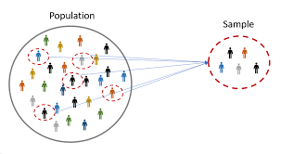
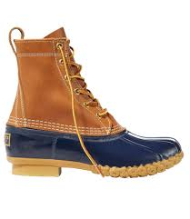
16CSE09 / Machine Learning Techniques
Unit - 3 / Session – 2
CO3: Develop Resampling and Model Selection Methods
Topic:
Resampling Methods
Cross Validation
Bootstrapping

Slide 2
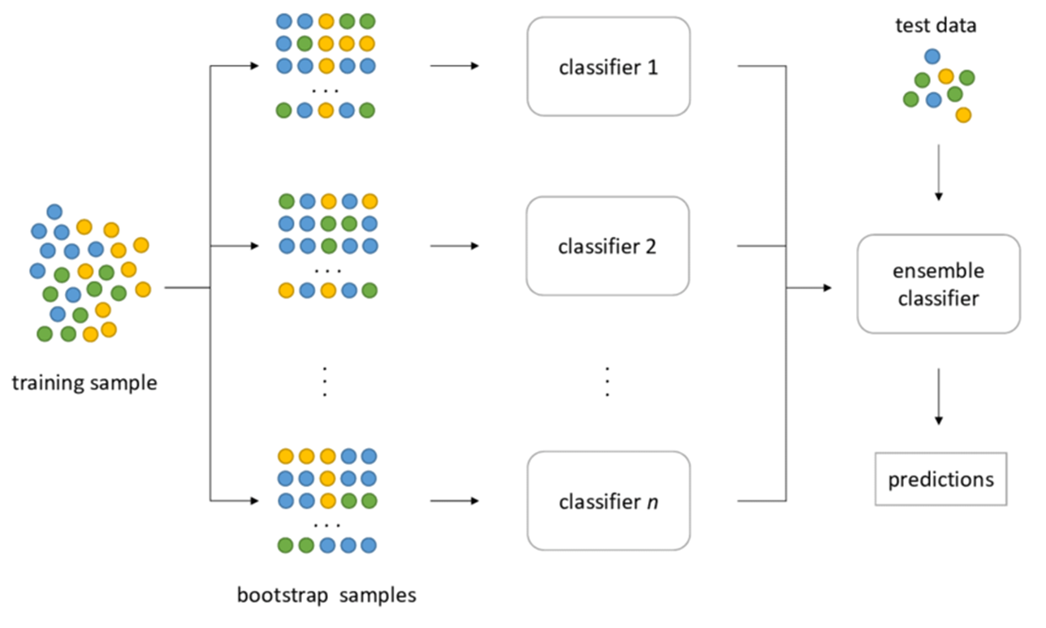
Bootstrapping
Ensemble learning helps improve machine learning results by combining several models.

Slide 3
Bootstrapping
The bootstrap method is a resampling technique used to estimate statistics on a population by sampling a dataset with replacement.
It can be used to estimate summary statistics such as the mean or standard deviation.
It is used in applied machine learning to estimate the skill of machine learning models when making predictions on data not included in the training data.
Sampling is a technique of selecting individual members or a subset of the population to make statistical inferences from them and estimate characteristics of the whole population.

Slide 4
Definition: Bootstrapping
The basic idea of bootstrap is make inference about a estimate (such as sample mean) for a population parameter Ꝋ (such as population mean) on sample data.
It is a resampling method by independently sampling with replacement from an existing sample data with same sample size n, and performing inference among these resampled data.

Slide 5
Definition: Bootstrapping
Bootstrapping resamples the original dataset with replacement many thousands of times to create simulated datasets. This process involves drawing random samples from the original dataset. Here’s how it works:
The bootstrap method has an equal probability of randomly drawing each original data point for inclusion in the resampled datasets.
The procedure can select a data point more than once for a resampled dataset. This property is the “with replacement” aspect of the process.
The procedure creates resampled datasets that are the same size as the original dataset.
The process ends with your simulated datasets having many different combinations of the values that exist in the original dataset. Each simulated dataset has its own set of sample statistics, such as the mean, median, and standard deviation.

Slide 6
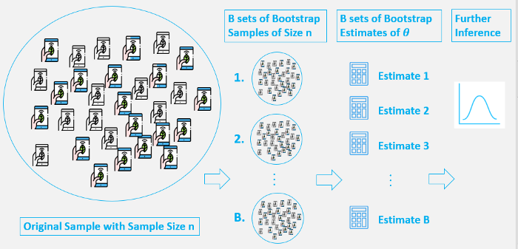
Bootstrap involves the following steps…

Slide 7
Bootstrap involves the following steps:
A sample from population with sample size n.
Draw a sample from the original sample data with replacement with size n, and replicate B times, each re-sampled sample is called a Bootstrap Sample, and there will totally B Bootstrap Samples.
Evaluate the statistic of Ꝋ for each Bootstrap Sample, and there will be totally B estimates of Ꝋ.
Construct a sampling distribution with these B Bootstrap statistics and use it to make further statistical inference, such as:
Estimating the standard error of statistic for Ꝋ .
Obtaining a Confidence Interval for Ꝋ .

Slide 8
Bootstrapping: Worked Example
Imagine we have a dataset with 6 observations:
[0.1, 0.2, 0.3, 0.4, 0.5, 0.6]
The first step is to choose the size of the sample. Lets sample size = 4.
Next, we must randomly choose the first observation from the dataset.
Let’s choose 0.2. so sample = [0.2]
This observation is returned to the dataset and we repeat this step 3 more times.
Now the sample = [0.2, 0.1, 0.2, 0.6]
We now have our data sample. The example purposefully demonstrates that the same value can appear zero, one or more times in the sample. Here the observation 0.2 appears twice.

Slide 9
Bootstrapping: Worked Example
An estimate can then be calculated on the drawn sample.
statistic = calculation([0.2, 0.1, 0.2, 0.6])
Observations not chosen for the sample may be used as out of sample observations.
oob = [0.3, 0.4, 0.5]
In the case of evaluating a machine learning model, the model is fit on the drawn sample and evaluated on the out-of-bag sample.
train = [0.2, 0.1, 0.2, 0.6]
test = [0.3, 0.4, 0.5]
model = fit(train)
statistic = evaluate(model, test)
That concludes one repeat of the procedure. It can be repeated 30 or more times to give a sample of calculated statistics. This sample of statistics can then be summarized by calculating a mean, standard deviation, or other summary values to give a final usable estimate of the statistic.

Slide 10
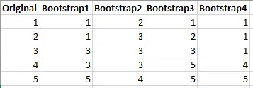
Example of Bootstrap Samples
Suppose a study collects five data points and creates four bootstrap samples, as shown below.

Slide 11
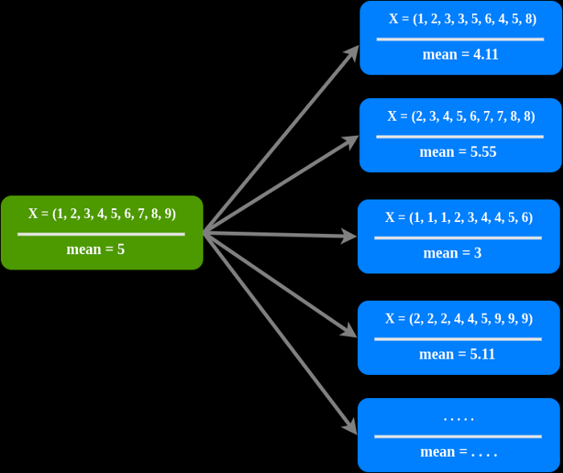
Example of Bootstrap Samples
This illustration uses 10 “dummy” data, this is only an example because in real cases 10 samples are not enough to bootstrap.

Slide 12
Recall the steps in Bootstrap….
Original Population With Sample Size N — A sample from population with sample size N.
B set Bootstrap Sample Size of N — Create a random sample with replacement from the original sample with sample size N as the original sample, replicate B time, and there will totally B Bootstrap Samples
B set Bootstrap Estimate Population Parameters — evaluate the resulting of population parameters
Further Inference — strong estimate of population parameters such as mean, standard error, confidence interval, etc.

Slide 13
Notes of The Bootstrap Method
The bootstrap method is not a way to reduce errors, but only tries to estimate errors.
The bootstrap distribution usually estimates the shape, spread, and bias of the actual sampling distribution.
The bootstrap process does not replace or add new data.
Bootstrapping cannot be done when :
The data are so small that they do not approach values in the population
The data has many outliers

Slide 14

Summary
In this session, we have learned about ,
Resampling based on Bootstrapping

